Slide 1
Regular Languages and Regular Grammars

Slide 2
Introduction:
One way of describing regular languages is via the notation of regular expressions.
This notation involves
a combination of strings of symbols from some alphabet Σ,
parentheses,
operators +,., and *.
The expression (a + (b·c))* stands for the star-closure of {a} ∪ {bc}, that is, the language {λ, a, bc, aa, abc, bca, bcbc, aaa, aabc,…}.
→ + to denote union, · for concatenation and * for star-closure.
Examples:
1. RE for the language L = {a} is a.
2. RE for the language L = {a, b, c} is a+b+c
3. RE for the language L = {λ, a, bc, aa, abc, bca, bcbc, aaa, aabc,… } is (a + bc)*

Slide 3
Formal Definition of a Regular Expression
Let Σ be a given alphabet, Then
1. Ø, λ and a ∈ Σ are all regular expressions. These are called primitive regular expressions.
2 If r1 and r2 are regular expressions, so are r1+ r2,r1.r2, r1*, and (r1).
3. A string is a regular expression if and only if it can be derived from the primitive regular expressions by a finite number of applications of the rules in (2).

Slide 4
Languages Associated with Regular Expressions
The language L(r) denoted by any regular expression r is defined by the following rules.
1. Ø is a regular expression denoting the empty set,
2. λ is a regular expression denoting {λ}.
3. For every a ∈ Σ, a is a regular expression denoting {a}.
If r1 and r2are regular expressions, then
4. L (r1 + r2) = L (r1)∪ L (r2),
5. L (r1 · r2) = L (r1) L (r2),
6. L ((r1)) = L (r1),
7. L (r1* ) = (L (r1))*.

Slide 5
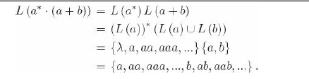
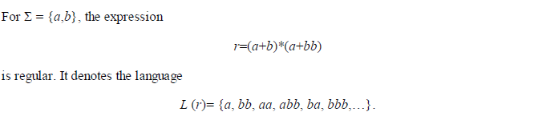
Example 1 - Exhibit the Language in set notation….
Example 2
L(r) is the set of all strings on {a, b}, terminated by either an a or a bb.

Slide 6
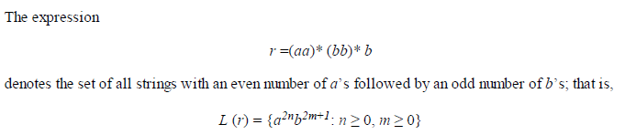
Example 3
Example 4
For Σ = {0, 1}, give a regular expression r such that
L(r) = {w ∈ Σ*: w has at least one pair of consecutive zeros} → r= (0 + 1)* 00(0 + 1)*.
L(r) = {w ∈ Σ*: w has no pair of consecutive zeros} → r= ( 1 + 01)* ( 0 + λ )
r= ( 0 + λ ) ( 1 + 10)*

Slide 7
Example 5
Language consisting of all strings having single 0 followed by any number of 1’s or single 1 followed by any number of 0’s. 01* + 10*
Example 6
Different ways of generating alternate a’s and b’s .
1. (ab)* 2. b (ab)* 3. (ba)* 4. a(ba)*
Example 7
Obtain a regular expression to accept a language with a’s and b’s of even length
(aa + ab + ba + bb)*
Example 8
Obtain a regular expression to accept a language with a’s and b’s of odd length
(aa + ab + ba + bb)* (a+b)

Slide 8
Example 9
Regular expression L(R) = { w| w ϵ (0,1) }* with at least 3 consecutive zeroes
(0+1) * 000 (0 +1)*
Example 10
Obtain RE to accept a’s and b’s ending with b and has no substring aa
(b + ab)* (b + ab)
Example 11
Obtain a regular expression to accept a language starting with a and ending with b
a (a+b)* b
Example 12
Obtain a regular expression to accept a language with a’s and b’s of either even or multiples of 3 or both
((a+b)(a+b))* + ((a+b)(a+b) (a+b))*

Slide 9

Connection between Regular Expressions and Regular Languages
For every regular language there is a regular expression, and for every regular expression there is a regular language.
Our definition says that a language is regular if it is accepted by some DFA.
Because of the equivalence of nfa's and dfa's, a language is also regular if it is accepted by some NFA.
Let r be a regular expression. Then there exists some nondeterministic finite accepter that accepts L(r).
(a) nfa accepts Ø.
(b) nfa accepts {λ}.
(c) nfa accepts {a}.

Slide 10

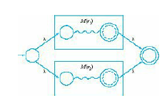

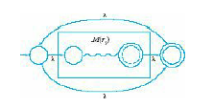
Schematic representation of an NFA accepting L(r).
Automaton for L(r1 + r2).
Automaton for L(r1r2).
Automaton for L( r1*).

Slide 11
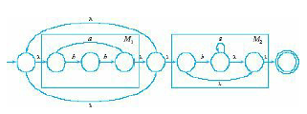
Find an nfa that accepts L(r), where r=(a + bb)* (ba* + λ)

Slide 12
Regular language
Regular language
NFA
NFA
Single accepting state
Single accepting state

Slide 13
Example

Slide 14
Union
NFA for

Slide 15
Example
NFA for

Slide 16
Concatenation
NFA for

Slide 17
Example
NFA for

Slide 18
How do we construct automata for the
remaining operations?
Union:
Concatenation:
Star:
Reversal:
Complement:
Intersection:

Slide 19
Star Operation
NFA for

Slide 20
Example
NFA for

Slide 21
Assignments
Obtain NFA which accepts strings a’s and b’s starting with a and b
Obtain NFA for regular expression (a*+b*+c*)
Obtain NFA for regular expression (a+b)* aa (a+b)*

Slide 22
Generalized Transition Graph (GTG)
A generalized transition graph is a transition graph whose edges are labeled with regular expressions.
The label of any walk from the initial state to a final state is the concatenation of several regular expressions,

Slide 23
From construct the equivalent
Generalized Transition Graph
in which transition labels are regular expressions
Example:

Slide 24
Procedure nfa-rex
Start with an nfa with states q0,q1, ...qn and a single final state , distinct from its initial state

Slide 25
Procedure nfa-rex
Start with an nfa with states q0,q1, ...qn and a single final state , distinct from its initial state
Convert the nfa into a complete generalized transition graph.
Let r_{ij} stand for the label of the edge from qi to qj

Slide 26
Procedure nfa-rex
.
3.If the generalized transition graph(GTG) has only 2 states with qi as initial and qj as final, as its associated regular expression is
r_{ii}* r_{ij} (r_{jj} + r_{ji} r_{ii} * r_{ij} )*

Slide 27
4. If GTG has 3 states with the initial state qi and final state qj and the third state qk, introduce new edge labelled
r_{pq} +r_{pk} r_{kk} * r_{kq} for p =i, j and q=i, j. When this is done the remove the vertex q_{k} and its associated edges.

Slide 28
5 . If GTG has 4 or more edges , pick a state q_{k} to be removed. Apply rule 4 for all pairs of states (q_{i} ,q_{j).} i≠k , j ≠k . At each step apply the simplifying rules
r+Ф =r
r Ф= Ф
Ф*=λ
Wherever possible. When this is done , remove q_{k}

Slide 29
6. Repeat step 3 to 5 until the correct regular expression is obtained.

Slide 30
Another Example:

Slide 31
Reducing the states:

Slide 32
Resulting Regular Expression:

Slide 33
In General
Removing states:

Slide 34
The final transition graph:
The resulting regular expression:

Slide 35
Standard Representations of Regular Languages
Regular Languages
FAs
Regular
Expressions
NFAs

Slide 36
When we say:
We are given
a Regular Language
We mean:
Language is in a standard
representation

Slide 37
Elementary Questions about Regular Languages

Slide 38
Question:
Given regular language
and string
how can we check if ?

Slide 39
Question:
Given regular language
and string
how can we check if ?
Answer:
Take the DFA that accepts
and check if is accepted

Slide 40
DFA
DFA

Slide 41
Question:
Given regular language
how can we check
if is empty: ?

Slide 42
Question:
Given regular language
how can we check
if is empty: ?
Answer:
Take the DFA that accepts
Check if there is any path from
the initial state to a final state

Slide 43
DFA
DFA

Slide 44
Question:
Given regular language
how can we check
if is finite?

Slide 45
Question:
Given regular language
how can we check
if is finite?
Answer:
Take the DFA that accepts
Check if there is a walk with cycle
from the initial state to a final state

Slide 46
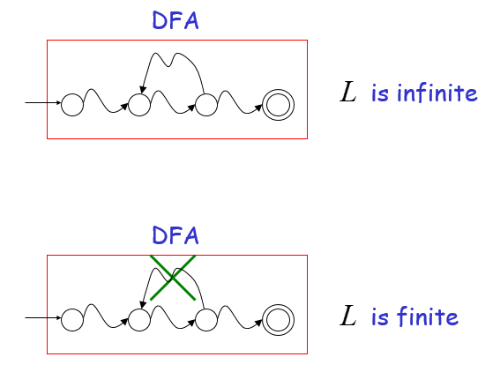

Slide 47
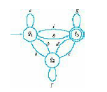
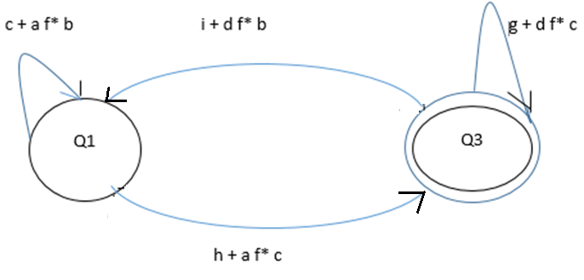
Find GTG for the following

Slide 48
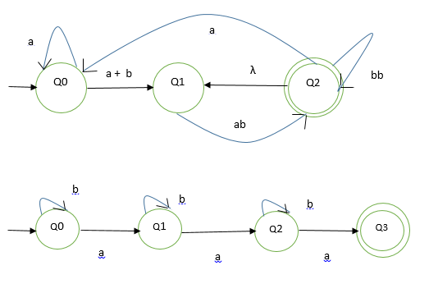
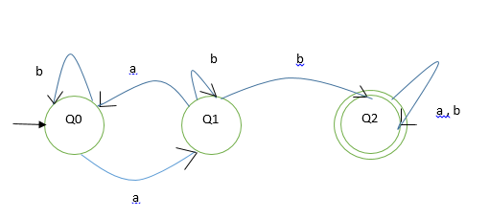
Find GTG for the following
1
a*(a+b)ab((bb + ab) + aa* (a+b) ab)*
2
b * a b* ab* a (Φ )*
3
(b + ab* a) * ab* (a + b)*

Slide 49
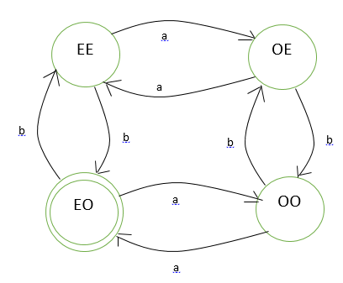
L = { w | even number of a’s and odd number of b’s}
4
R1 = aa + ab(bb)* ba
R2 = b + ab(bb)*a
R3 = b + a(bb)*ba
R4 = a (bb)* a
Substitute in R = r1* r2(r4 + r3r1*r2)*

Slide 50
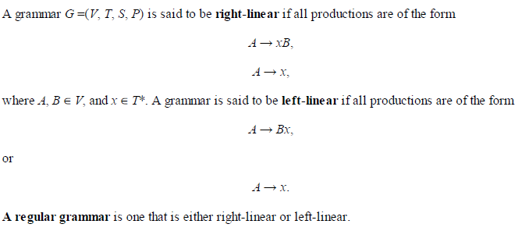
Regular Grammars
Right- and Left-Linear Grammars
In a regular grammar, at most one variable appears on the right side of any production. Furthermore, that variable must consistently be either the rightmost or leftmost symbol of the right side of any production.

Slide 51
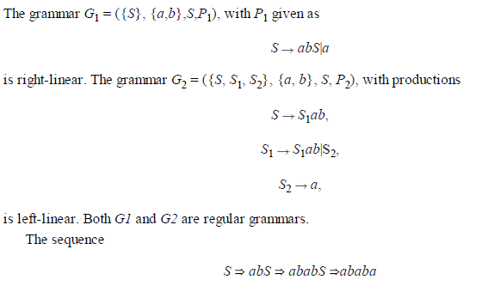
L (G1) is the language denoted by the regular expression r = (ab)* a.
In a similar way, we can see that L(G2) is the regular language L(aab(ab)*).

Slide 52
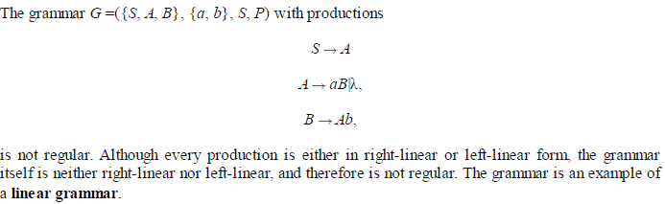
Linear Grammars
A linear grammar is a grammar in which at most one variable can occur on the right side of any
production, without restriction on the position of this variable.

Slide 53
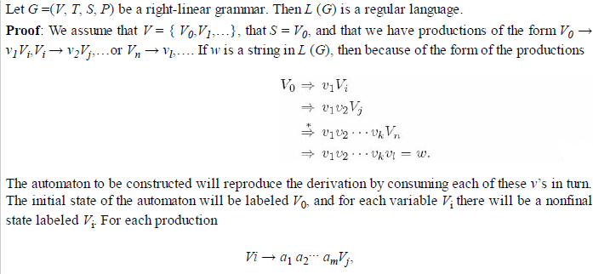
Right-Linear Grammars Generate Regular Languages
V₀ → v₁ V_{i}
V_{i} → v₂V_{j}
…
V_{n} → v_{l}

Slide 54
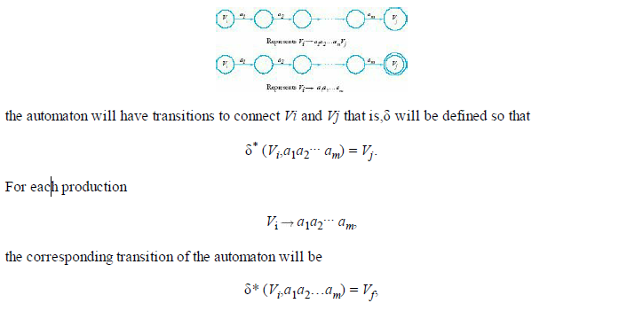
where Vf is a final state.

Slide 55
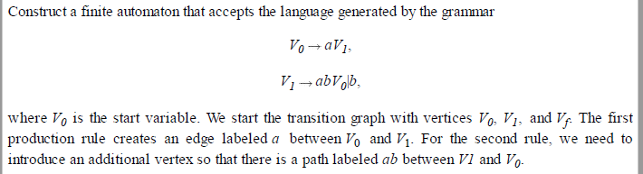
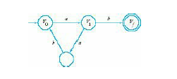
The language generated by the grammar and accepted by the automaton is the regular language
L ((aab) * ab.

Slide 56
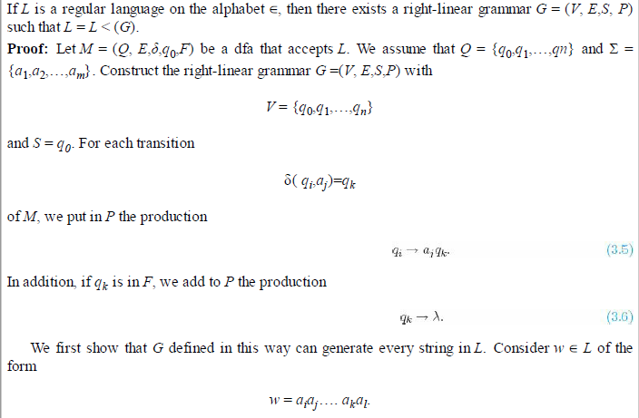
Right-Linear Grammars for Regular Languages
Take example aab*a

Slide 57
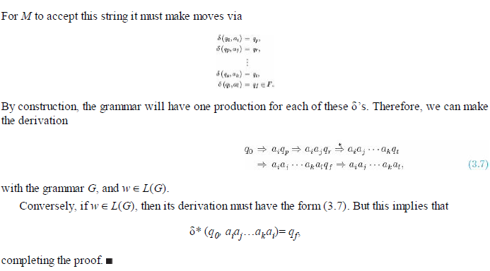
δ(q0, ai) = qp
δ(qp, aj) = qr
:
:
δ(qs, ak) = qt
δ(qt, al) = qf
qf ϵ F

Slide 58
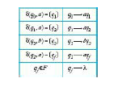
Construct a right-linear grammar for L (aab*a).
The string aaba can be derived with the constructed grammar by
q0 ⇒ aq1 ⇒ aaq2 ⇒ aabq2 ⇒ aabaqf ⇒ aaba.
δ(q0, a) = q1
δ(q1, a) = q2
δ(q2, b) = q2
δ(q2, a) = qf
qf ϵ F
q0 → aq1
q1→ aq2
q2→ bq2
q2→ aqf
qf ϵ F

Slide 59
Construct DFA that accepts the language generated by the grammar
S → abA
A → baB
B → aA | bb
a b b
b a a
a
S
V_{i}
A
V_{j}
a
T
B
L = { abba (aba)* bb }
b
V_{k}
b
V_{f}

Slide 60
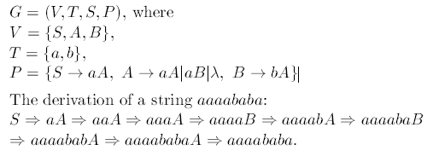
2. Find regular grammar that generate L (aa*(ab + a)*)

Slide 61
3. Construct right linear and left linear grammar for the language
L = {a^{n} b^{m} : n >= 2, m >=3}
Right Linear:
S → aaA
A → aA | B
B → bbbC
C → bC | λ
Left Linear:
S → Abbb
A → Ab | B
B → Caa
C → Ca | λ
1) Draw DFA for the following
S → 01 A
A → 10B
B → 0A | 11
Draw DFA for the following
S → aA | λ
A → aA | bB | λ
B → bB | λ

Slide 62
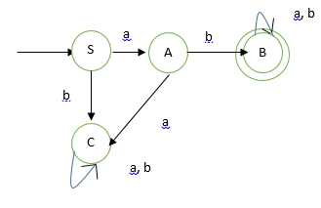
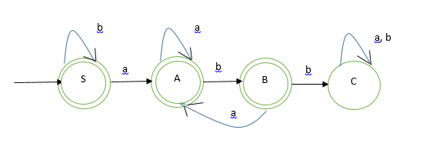
b) Construct regular grammar for the following
Construct regular grammar for the following

Slide 63
b) Construct regular grammar for the following
Construct regular grammar for the following
S → aA | bC
A → aC | bB
B → aB | bB | λ
C → aC | bC
S → aA | bS | λ
A → aA | bB | λ
B → aA | bC | λ
C → aC | bC

Slide 64
Obtain Right Linear Grammar for the RE ((aab)* ab)*
S → abA | aabB | λ
A → abA | aabB | λ
B → aabB | abA
ab
ab
S
A
ab
aab
B
aab
aab

